Slide 1
CUSTOMER RETENTION
BY Ankit anand

Slide 2
Contents
Problem Statement
Definition
Benefits of Customer Retention
EDA Steps
Visualizations
Analysis
Conclusion
Limitation

Slide 3
Problem Statement
This dataset has given some customers personal details , devices details, OS ,Shopping frequency ,Payment methods etc. and their poll for user friendly interface ,attractive offers ,Customer privacy etc. for some of the leading e commerce sites like Amazon, Flipkart, Paytm, Myntra, Snapdeal. I have to analyze the given data and do all the EDA and visualization steps and Assumption to make a model which can predict about customer retention.

Slide 4
Definition
Customer retention refers to the ability of a company or product to retain its customers over some specified period. High customer retention means customers of the product or business tend to return to, continue to buy or in some other way not defect to another product or business, or to non-use entirely.

Slide 5
Benefits of Customer Retention
Retention is Cheaper than Acquisition.
Loyal Customers are More Profitable.
Company’s Brand Will Stand Out from the Crowd.
Company will Earn More Word of Mouth Referrals.
Engaged Customers Provide More Feedback.
Customers Will Explore Your Brand.
Loyal Customers are More Forgiving.
Improve Brand image.

Slide 6
Exploratory Data Analysis(EDA)
Imported necessary libraries and loaded the dataset.
Checked null values. There is not any null value.
Performed both univariate and bivariate analysis and visualized each feature using seaborn and matplotlib libraries by plotting count plot, pie plot, dist plot, and box plots.

Slide 7
Data and Assumptions
The given data contains 269 surveyors and 71 questionnaire.
Few of the questions that have been asked fall in the following categories:-
1.Personal Information like Gender, Age, City, Pincode, device,internet-connection etc.
2. Since how long customer shop online, frequency with in one year, Abandon frequency and reason, important factors to make purchase decision and drives satisfaction.
3. Poll for e-commerce sites which satisfies the above factors to make purchase decision and drives satisfaction.
The Assumption for this analysis is that, when we recommend something to a friend, It means that we have used it and found it satisfactory .

Slide 8
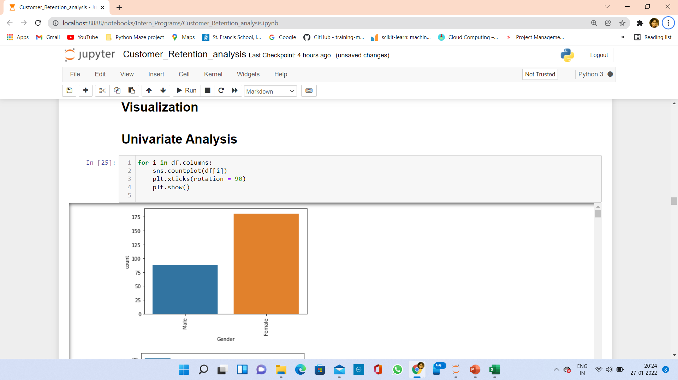
Visualization
Analysis:- Most of the customers that us e-commerce websites for making purchases are Female..

Slide 9
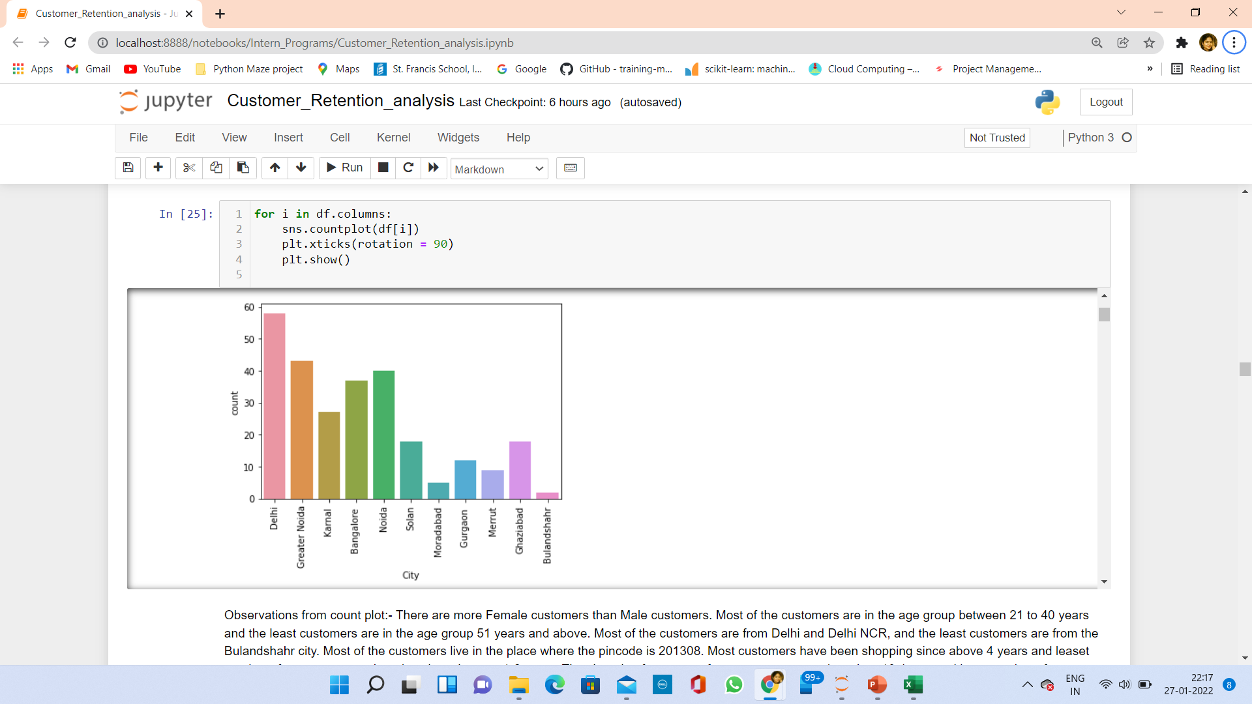
Visualization
Analysis :- Most of the customers are from Delhi.

Slide 10
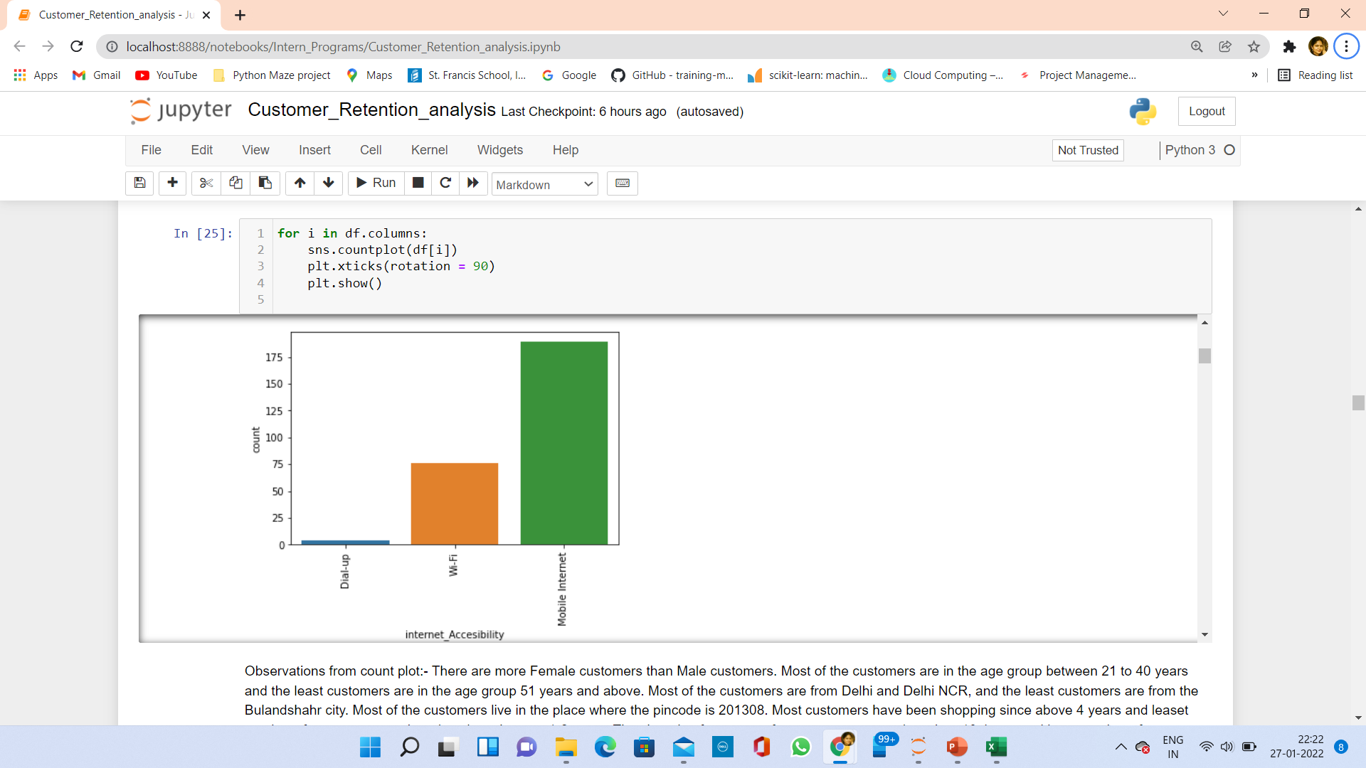
Visualization
Analysis : Most of the customers use mobile internet for online shopping.

Slide 11
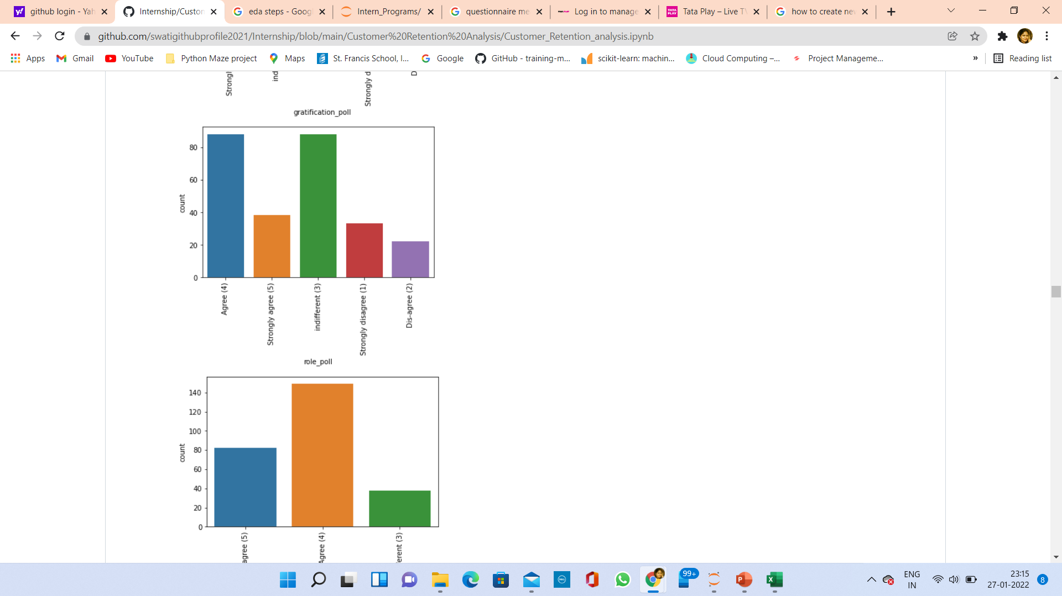
Visualization
Analysis : Most of the customers agree that Shopping on the website helps them fulfill certain roles.

Slide 12
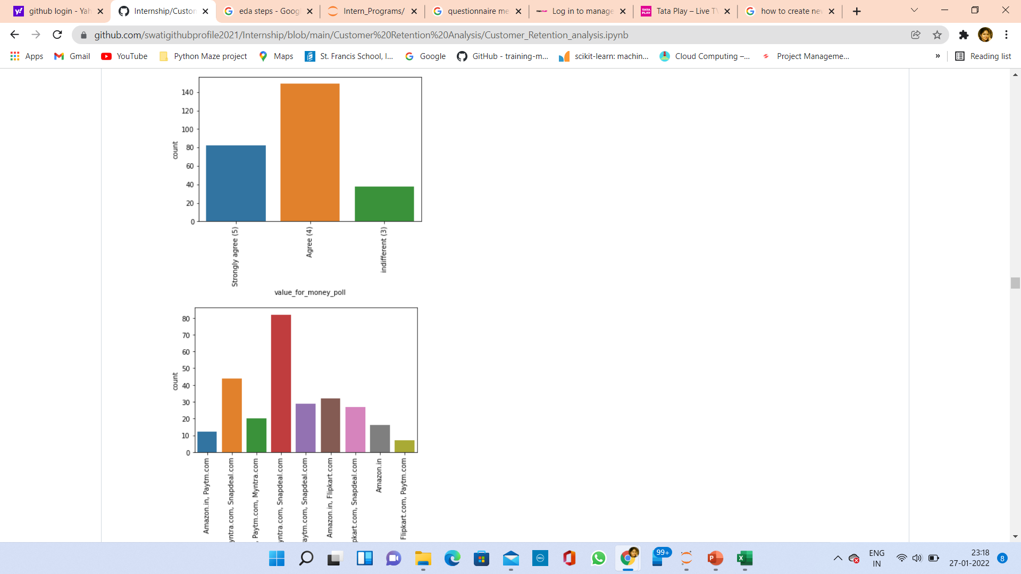
Visualization
Analysis : Most of the customers agree that they are getting value for the money spent on e commerce websites.

Slide 13
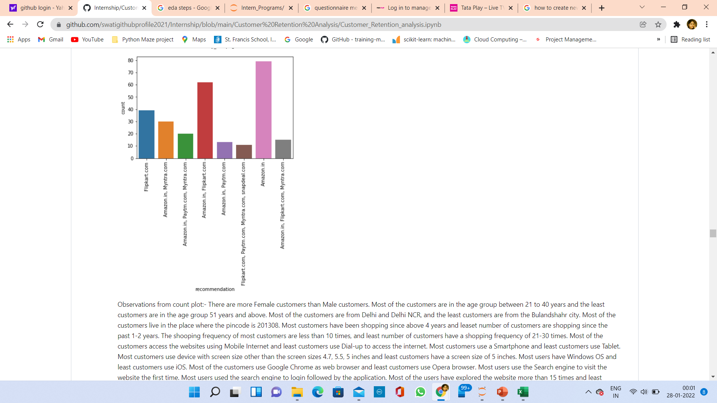
Visualization
Analysis : Most of the customers recommend
To use Amazon.in for online shopping.

Slide 14
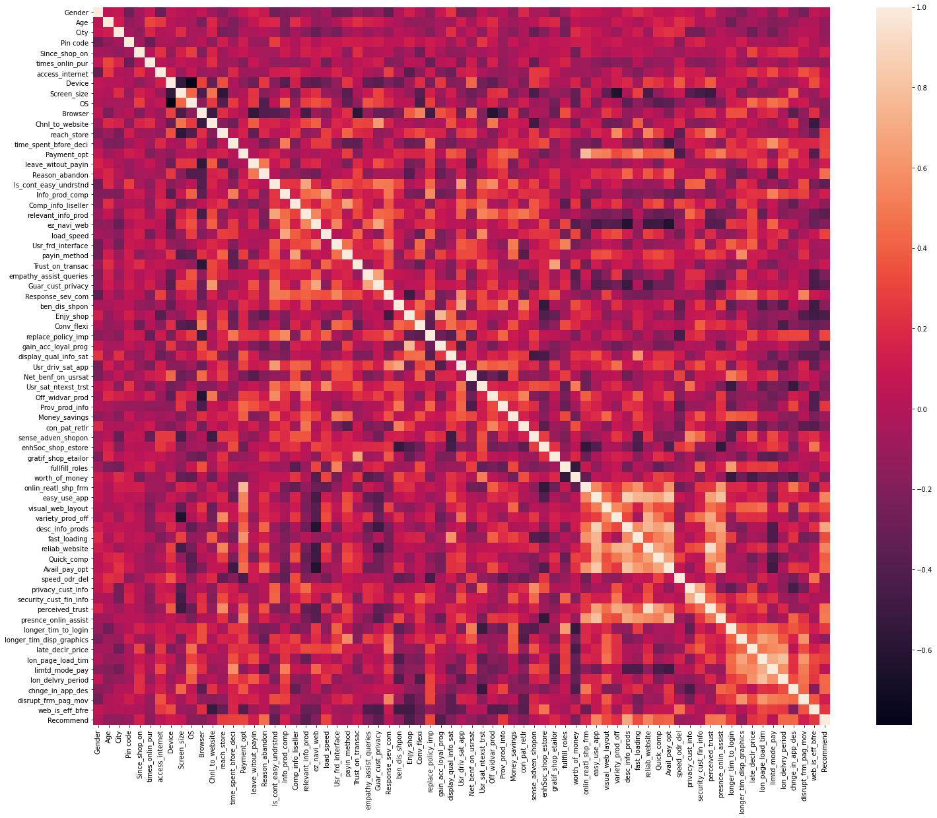

CORRELATION

Slide 15
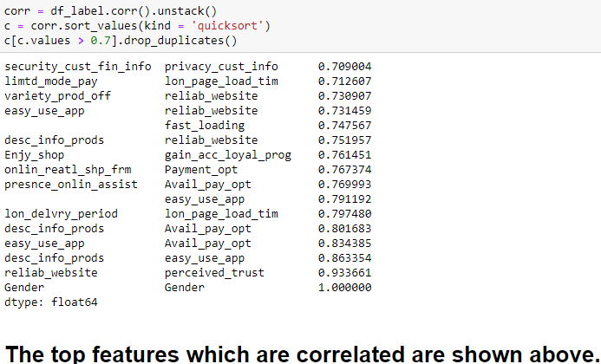
We can observe that there are many variables which have high and low correlation with other independent variables.
We have to use correlation matrix to check the relation/dependencies between the independent and target variables.
We have to remove one of the highly correlated independent variable to get rid of the problem of multicollinearity.

Slide 16
Conclusion
According to above analysis, The e commerce site with highest retention and customer satisfaction rates are Amazon.in and Flipkart.com because their positives are in line with the customer preferences and they are most likely to use these websites for purchases in the future.
The company with very low retention rate and customer satisfaction is with Paytm and Snapdeal because most of the factors are not in line with the customer preferences
Finally I would say that, customer satisfaction plays a major role in retention. A company should first understand what customers expects while purchasing online (e-commerce) and provide a better buying experience which will in turn retain the customer.
Some of the customers believe that online shopping is not trustworthy and reliable because of only online payment mode personal privacy and lack of trust.

Slide 17
THANK YOU

